Slide 1


Engineering
Merit Badge
Troop 344 and 9344
Pemberville, OH

Slide 2
Requirements
Select a manufactured item in your home (such as a toy or an appliance) and, under adult supervision and with the approval of your counselor, investigate how and why it works as it does. Find out what sort of engineering activities were needed to create it. Discuss with your counselor what you learned and how you got the information.
Select an engineering achievement that has had a major impact on society. Using resources such as the Internet (with your parent's permission), books, and magazines, find out about the engineers who made this engineering feat possible, the special obstacles they had to overcome, and how this achievement has influenced the world today. Tell your counselor what you learned.
Explain the work of six types of engineers. Pick two of the six and explain how their work is related.

Slide 3
Requirements
Visit with an engineer (who may be your counselor or parent) and do the following:
  Discuss the work this engineer does and the tools the engineer uses.
  Discuss with the engineer a current project and the engineer’s particular role in it.
  Find out how the engineer’s work is done and how results are achieved.
  Ask to see the reports that the engineer writes concerning the project.
  Discuss with your counselor what you learned about engineering from this visit.
Use the systems engineering approach to design an original piece of patrol equipment, a toy or a useful device for the home, office or garage.

Slide 4
Requirements
Do TWO of the following:
  Transforming motion. Using common material or a construction set, make a simple model that will demonstrate motion. Explain how the model uses basic mechanical concepts like levers and inclined planes to demonstrate motion. Describe an example where this mechanism is used in a real product.
  Using electricity. Make a list of 10 electrical appliances in your home. Find out approximately how much electricity each uses in one month. Learn how to find out the amount and cost of electricity used in your home during periods of light and heavy use. List five ways to conserve electricity.
  Understanding electronics. Using an electronic device such as a smartphone or tablet computer, find out how sound, video, text or images travel from one location to another. Explain how the device was designed for ease of use, function, and durability.
  Using materials. Do experiments to show the differences in strength and heat conductivity in wood, metal, and plastic. Discuss with your counselor what you have learned.
  Converting energy. Do an experiment to show how mechanical, heat, chemical, solar, and/or electrical energy may be converted from one or more types of energy to another. Explain your results. Describe to your counselor what energy is and how energy is converted and used in your surroundings.
  Moving people. Find out the different ways people in your community get to work. Make a study of traffic flow (number of vehicles and relative speed) in both heavy and light traffic periods. Discuss with your counselor what might be improved to make it easier for people in your community to get where they need to go.
  Building an engineering project. Enter a project in a science or engineering fair or similar competition. (This requirement may be met by participation on an engineering competition project team.) Discuss with your counselor what your project demonstrates, the kinds of questions visitors to the fair asked you about it, and how well were you able to answer their questions.

Slide 5
Requirements
Explain what it means to be a registered Professional Engineer (PE). Name the types of engineering work for which registration is most important?
Study the Engineer's Code of Ethics. Explain how it is like the Scout Oath and Scout Law.
Find out about three career opportunities in engineering. Pick one and research the education, training, and experience required for this profession. Discuss this with your counselor, and explain why this profession might interest you.

Slide 6
Requirement #1
Select a manufactured item in your home (such as a toy or an appliance) and, under adult supervision and with the approval of your counselor, investigate how and why it works as it does. Find out what sort of engineering activities were needed to create it. Discuss with your counselor what you learned and how you got the information.

Slide 7
Requirement #2
Select an engineering achievement that has had a major impact on society. Using resources such as the Internet (with your parent's permission), books, and magazines, find out about the engineers who made this engineering feat possible, the special obstacles they had to overcome, and how this achievement has influenced the world today. Tell your counselor what you learned.
Examples include the following:
  Interstate Road System
  Roman Aquaducts
  Apollo Missions to the Moon
  Telephone
  Light Bulb
  Transcontinental Railroad

Slide 8
Requirement #3
Explain the work of six types of engineers. Pick two of the six and explain how their work is related.

Slide 9
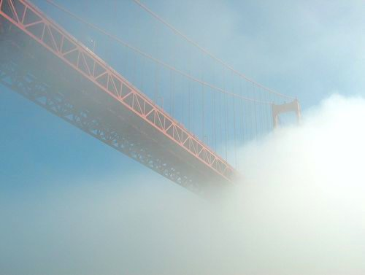
What is Engineering?
Engineering is the application of science and mathematics to improve society
Engineers exist to design, construct, operate, or maintain the systems and devices that drive our society, making them as effective and efficient as possible
The bottom line: engineering is problem solving
Engineering is the art or science of making practical.
~ Samuel C. Florman

Slide 10
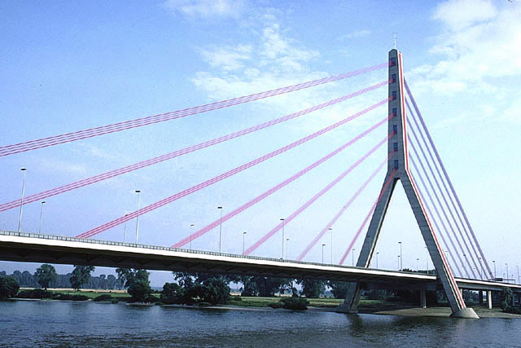
Types of Engineering
There are over a hundred different fields that engineers can specialize in.

Slide 11
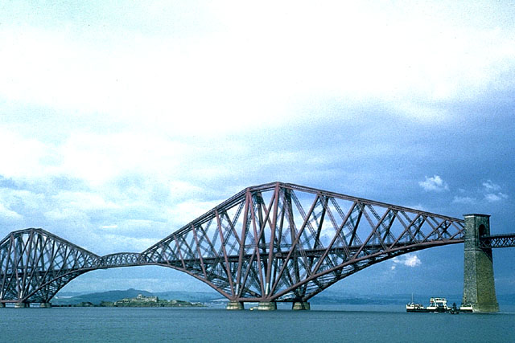
The Basic Engineering Fields
Civil
Environmental
Mechanical
Electrical
Chemical
Biological
Industrial
Software
Materials
Nuclear
Aerospace

Slide 12
Common Characteristics
Strong math background
Effective speakers
Good communication skills
Good writers

Slide 13
Which direction to choose???
Do You Fit the Profile to be an Engineer???
http://www.tame.org/engquiz/engineer1a/indexframe.htm

Slide 14

Civil
Engineering

Slide 15
Civil Engineering
Civil engineers meet societies need for infrastructure and water systems.
Civil Engineering is the most diverse discipline because of the wide range of subcategories:

Slide 16
Civil Engineering
A civil engineer might be asked to:
  Design a bridge
  Build a dam
  Determine the safest speed of a road
  Analyze data on the soil for a foundation
  Interpret numbers to forecast future traffic problems

Slide 17
Civil Engineering
Subcategories:
  Structures
  Geotechnical
  Transportation
  Water Resources
  Surveying
  Environment

Slide 18

Civil Engineering: Structures
Design and construction of adequate buildings, bridges, skyscrapers.

Slide 19
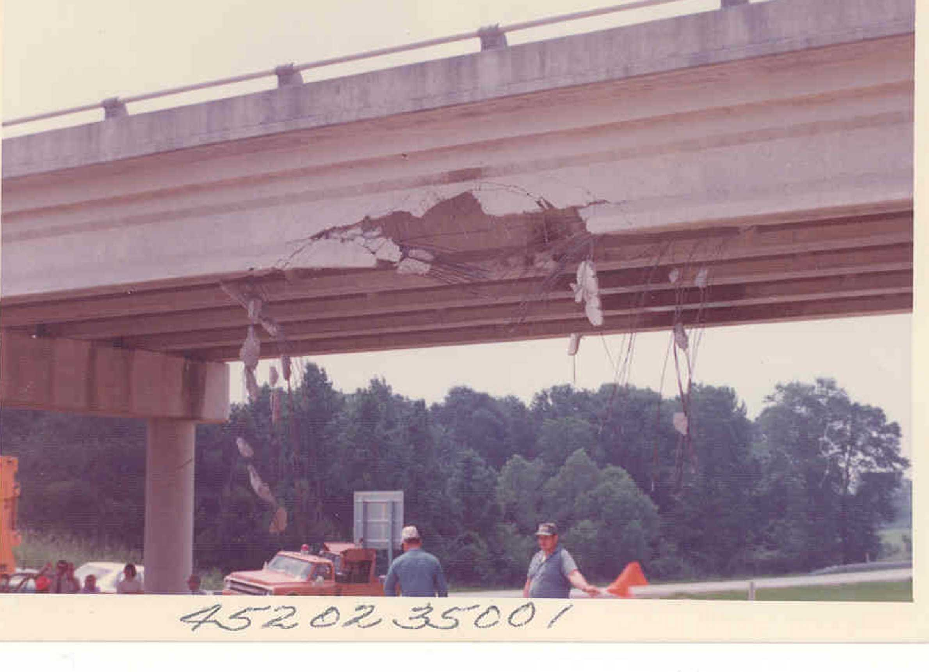
Civil Engineering: Structures
Involves determining the strength of materials being used and amount weight that is to be expected.
Is this structure still safe for use?

Slide 20
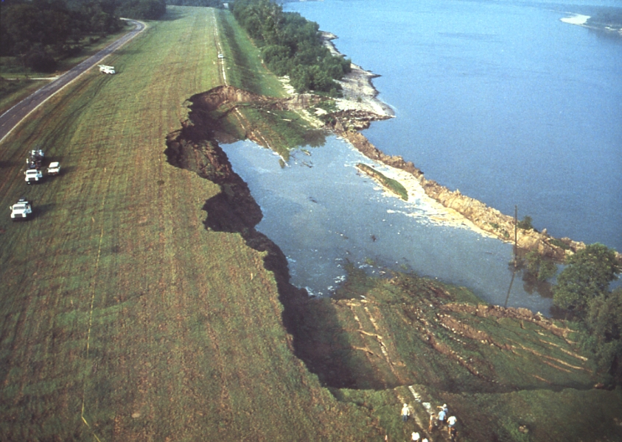
Civil Engineering: Geotechnical
Study of soils, or dirt
Applications: building foundations, underground facilities, tunnels, levees
Significant because everything built rests on soil.

Slide 21
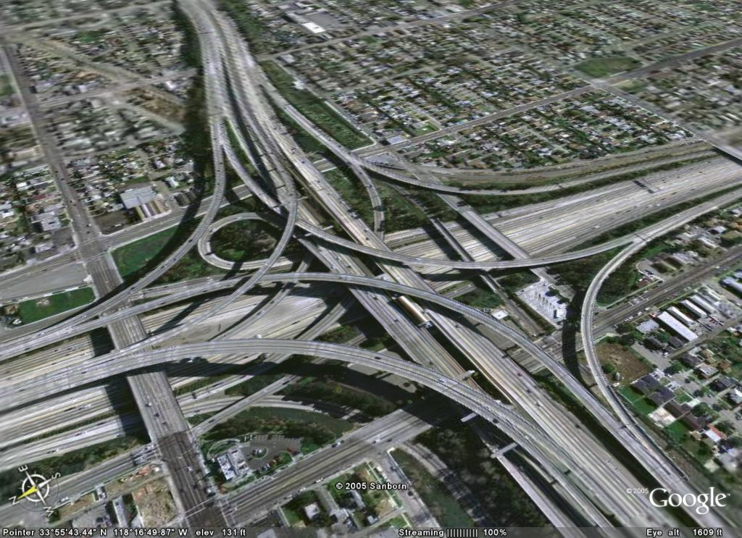
Civil Engineering: Transportation
Safe movement of people and cargo
Includes roads, railway, airports, subway.

Slide 22

Civil Engineering: Surveying
Establish boundary lines and borders.
Determines elevations.
Draw topographic maps
Before construction of a building or road, a survey must be done to mark the building location

Slide 23

Civil Engineering: Water Resources
Control and use of water: flood, irrigation, hydroelectric power, groundwater.
Applied to the construction of sewers or ditches.

Slide 24
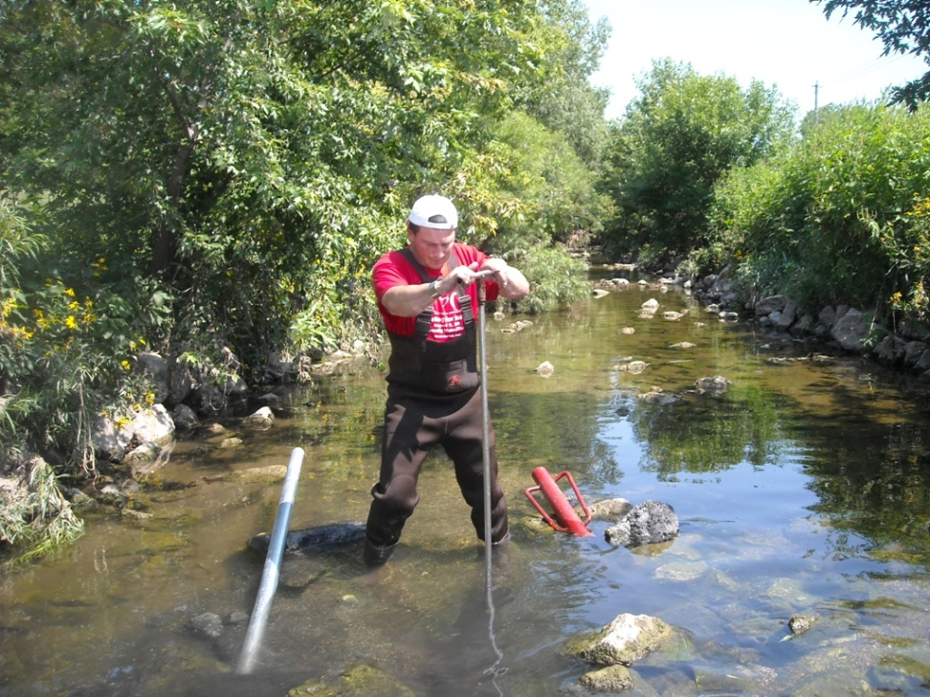
Environmental Engineering
Environmental engineering is the protection and restoration of the environment.
Environmental engineers have an expertise in water/air quality, water and wastewater treatment.

Slide 25
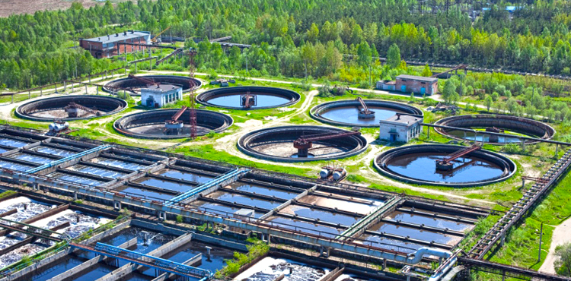
Environmental Engineering
An environmental engineer might be asked to:
Design a wastewater treatment facility
Determine how to dispose of toxic chemicals
Use computer models to figure out how much pollution a city will create

Slide 26

Environmental Engineering
Air pollution
Solid waste disposal
Hazardous waste treatment
Recycling
Storm water
Wastewater
Use models

Slide 27
Engineering Job Functions
Design
Analysis
Testing
Research
Sales
Management
Consulting
Teaching

Slide 28

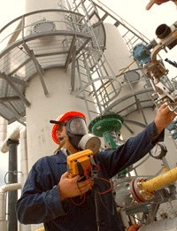
What is an Engineer’s #1 Priority?

Slide 29
Requirement #5
Use the systems engineering approach to design an original piece of patrol equipment, a toy or a useful device for the home, office or garage.

Slide 30
The Systems Engineering Process
State the problem. Stating the problem is the most important systems engineering task. It entails identifying customers, understanding customer needs, establishing the need for change, discovering requirements and defining system functions.
Investigate alternatives. Alternative solutions are investigated and evaluated based on performance, cost and risk.

Slide 31
The Systems Engineering Process
Model the system. Running models clarifies requirements, reveals bottlenecks and fragmented activities, reduces cost and exposes duplication of efforts.
Integrate. Integration means designing interfaces and bringing system elements together so they work as a whole. This requires extensive communication and coordination among all participants.

Slide 32
The Systems Engineering Process
Launch the system. Launching the system means running the system and producing outputs -- making the system do what it was intended to do.
Assess performance. Performance is assessed using evaluation criteria and performance measures. Measurement is the key. If you cannot measure it, you cannot control it. If you cannot control it, you cannot improve it.

Slide 33
The Systems Engineering Process
Re-evaluation. Re-evaluation should be a continual and repeating process with the results of one repetition being used as the starting point for the next.

Slide 34
Let’s Do an Example
An environmentally concerned client wants to change her home heating system from electricity to gas in order to dramatically reduce her heating costs.

Slide 35
Redefine
What is the most cost-effective change the woman can make to reduce her energy costs?

Slide 36
Identify Constraints
Home is heated by an electric system
House has single pane windows and little insulation in the attic
Energy costs are significantly higher than those of others in her area with
comparable homes
Environmentally concerned

Slide 37
Add Specifications
Your solution must be…
Feasible
Safe
Legal
Practical

Slide 38
Look at Potential Causes
  What would create a high electricity bill?
Identify Possible Solutions
  Brainstorm possible solutions
Analyze the Alternatives
  Construct a matrix and time chart

Slide 39
Time Chart
One Kind of Matrix
Solution | Cost | Time | Appearance
Switch from electricity to gas | $5000 | 2 Weeks | No Change
Add Insulation | $450 | 5 Days | No Change
Brick in existing windows | $300 | 2 Days | Big Change
Install high-efficiency pump | $2500 | 10 Days | Small Change
Add two-pane window | $500 | 8 Days | Small Change
Event | Day Number
 | 1 | 2 | 3 | 4 | 5
Order Insulation | X
Delivery |  | X | X
Remove Wall Panels |  |  | X
Install |  |  |  | X
Completion |  |  |  |  | X

Slide 40
Requirement #6
Do the following :
  Transforming motion. Using common material or a construction set, make a simple model that will demonstrate motion. Explain how the model uses basic mechanical concepts like levers and inclined planes to demonstrate motion. Describe an example where this mechanism is used in a real product.
  Converting energy. Do an experiment to show how mechanical, heat, chemical, solar, and/or electrical energy may be converted from one or more types of energy to another. Explain your results. Describe to your counselor what energy is and how energy is converted and used in your surroundings.
  Building an engineering project. Enter a project in a science or engineering fair or similar competition. (This requirement may be met by participation on an engineering competition project team.) Discuss with your counselor what your project demonstrates, the kinds of questions visitors to the fair asked you about it, and how well were you able to answer their questions.
To meet requirements #5 and #6 we will do a Rube Goldberg Contest
  See handout for contest rules and requirements.

Slide 41
Want to get into an engineering school?
High School Courses to take…
Math
Algebra
Trigonometry
Geometry
Pre-Calculus
Science
Biology
Chemistry
Physics
Electives
Drafting
Computer Science
- Don’t forget English and foreign languages…

Slide 42
The College Education
Can’t decide which engineering you like? First year is the same for everyone.
All students take the same math and science courses.
Purpose of engineering classes:
  Develop the “engineering mind”

Slide 43
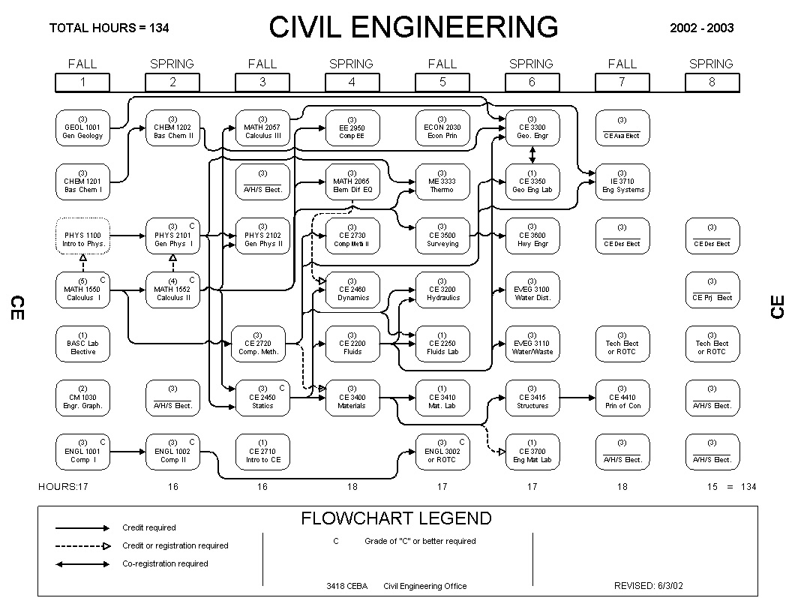

Slide 44
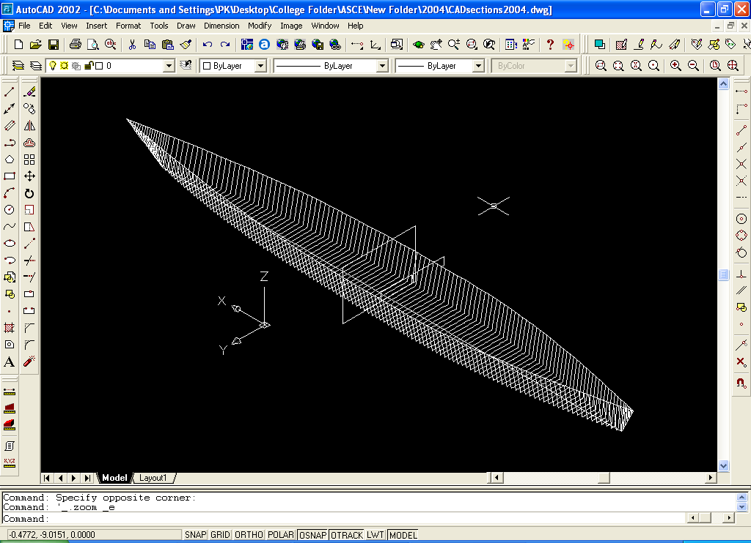
Concrete Canoe Contest

Slide 45
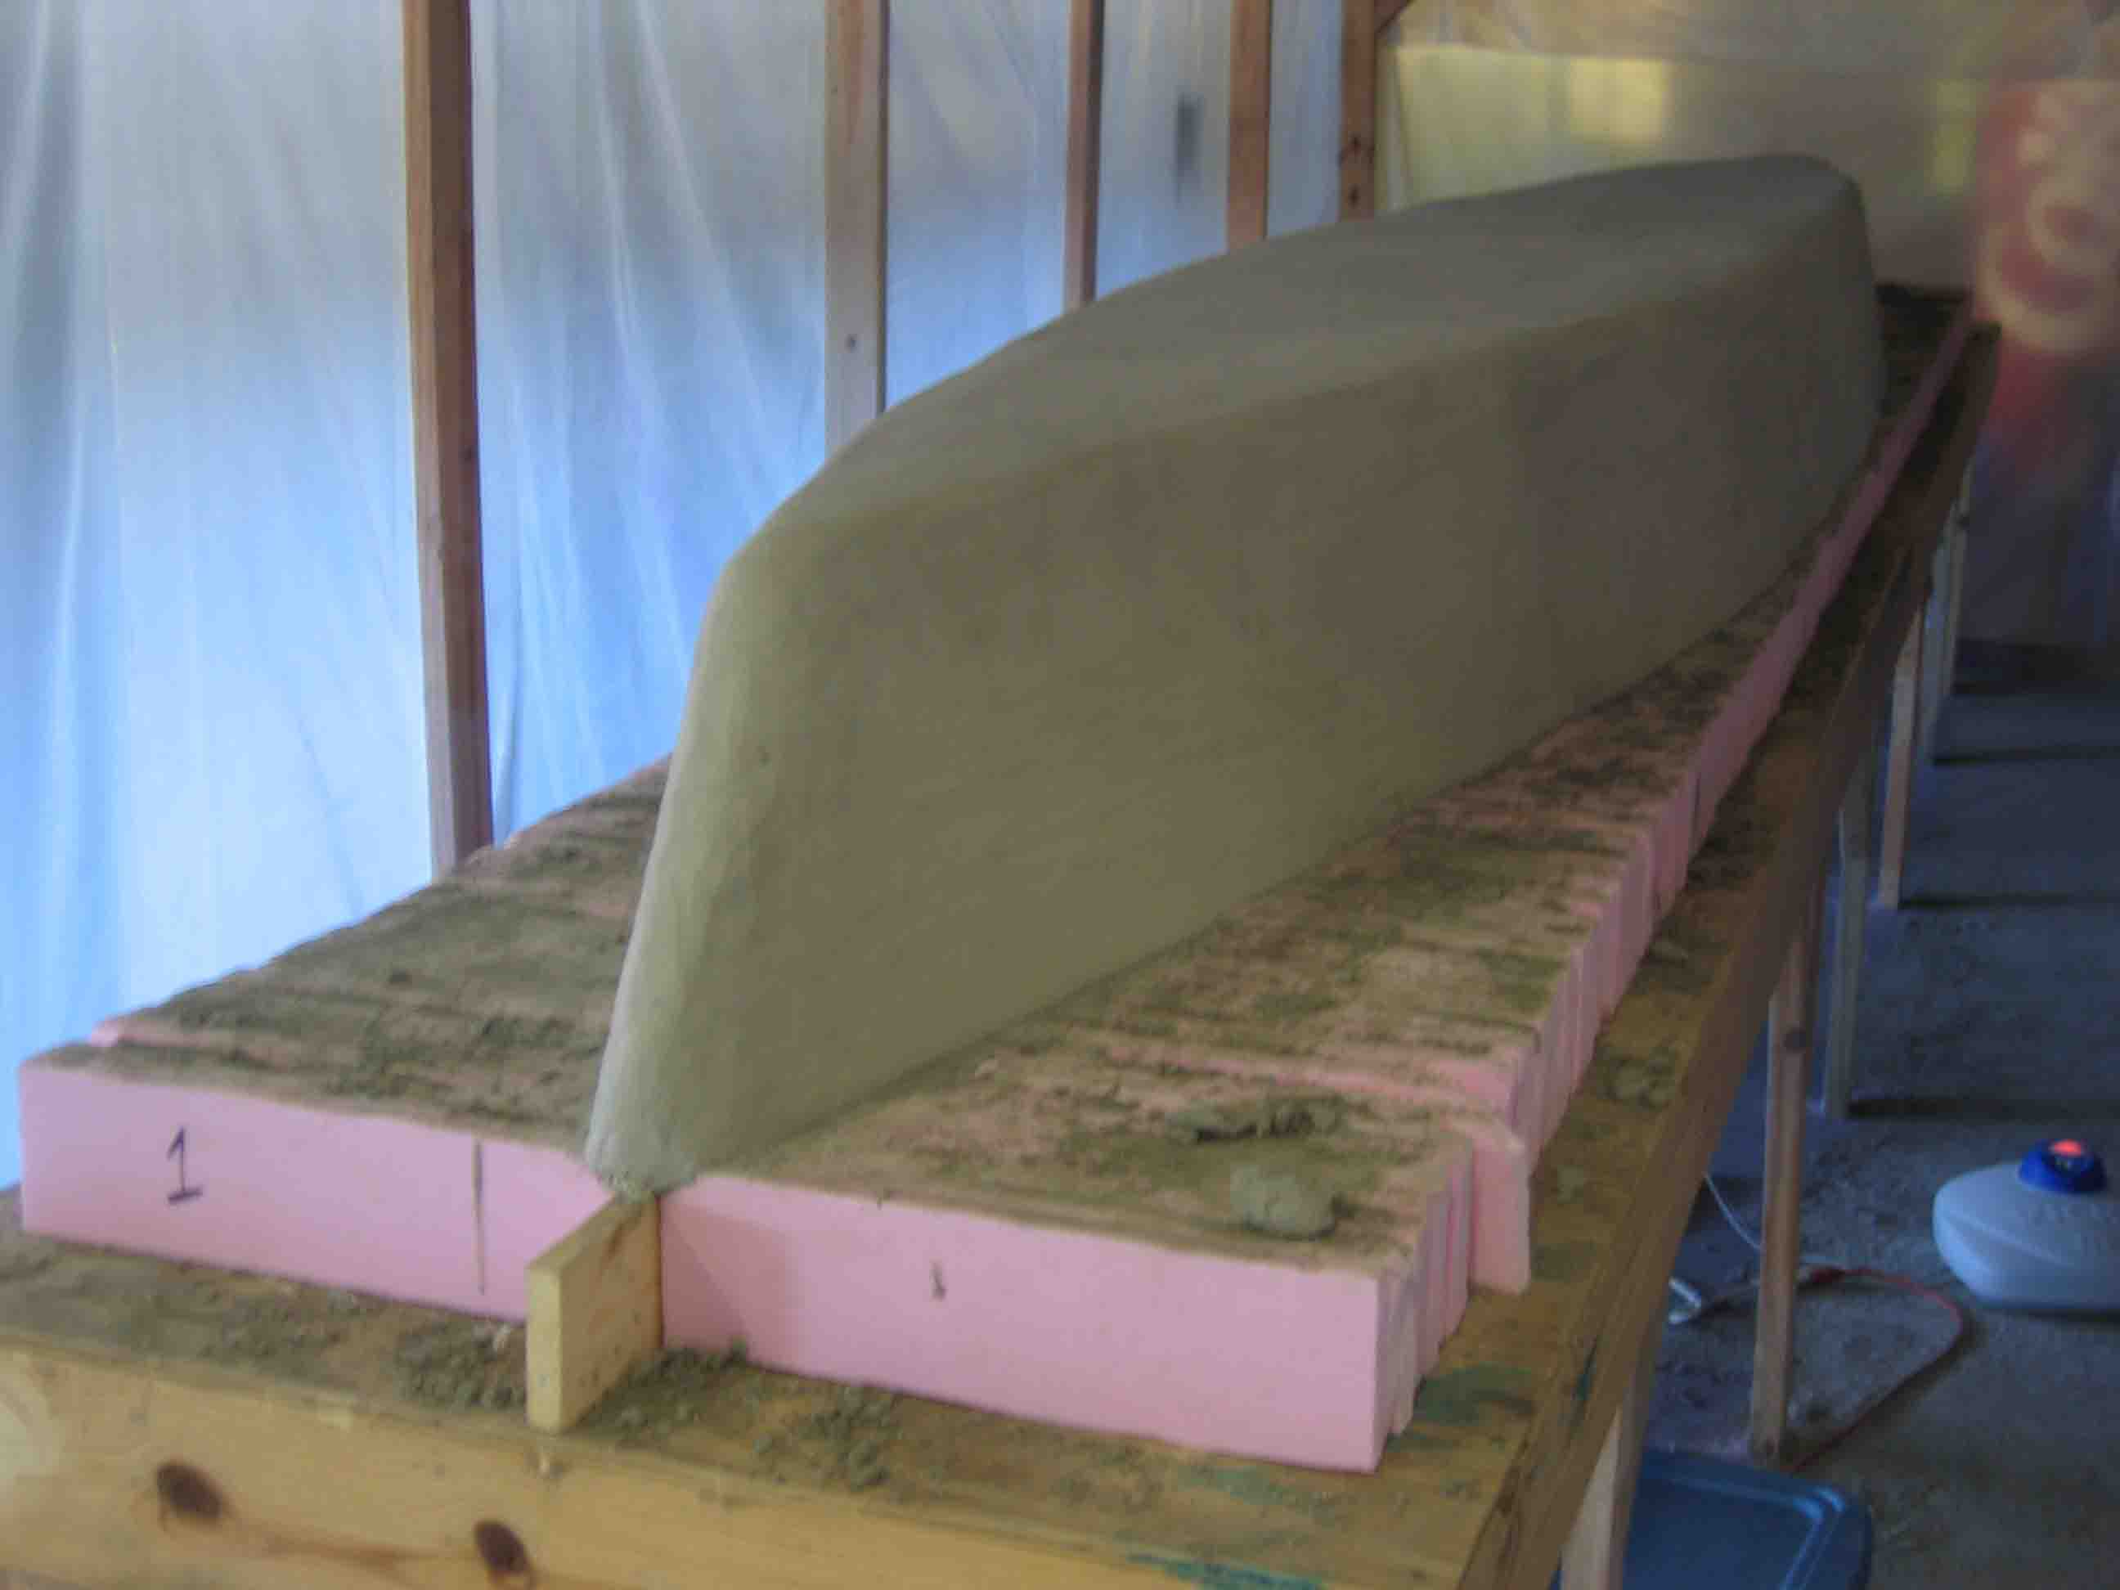
Concrete Canoe Contest

Slide 46
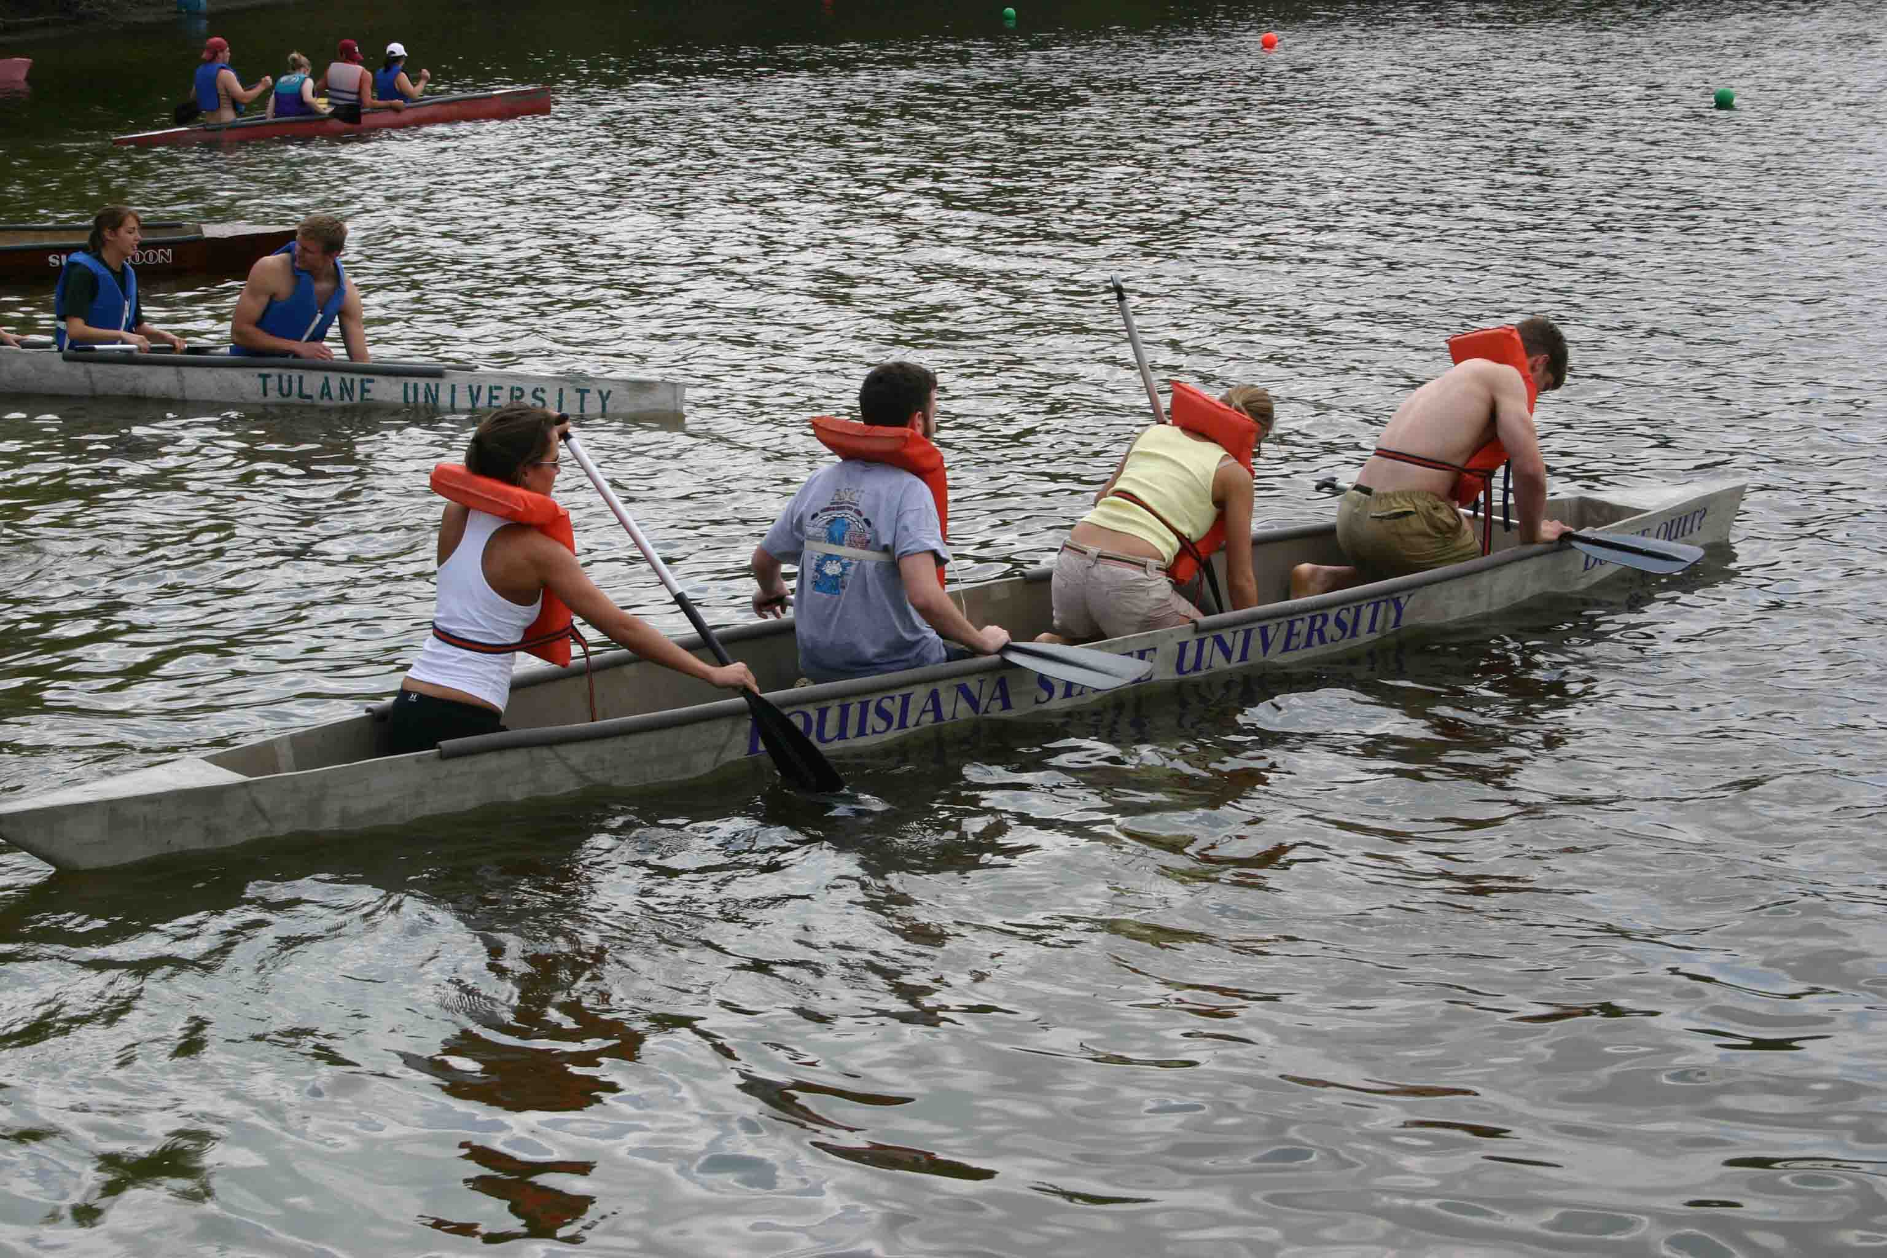
Concrete Canoe Contest

Slide 47
Requirement # 7
Explain what it means to be a registered Professional Engineer (PE). Name the types of engineering work for which registration is most important?

Slide 48
The Registered Professional Engineer
“Qualified” individual who holds a license to practice engineering in their state
Specific discipline oriented (Civil, Mechanical, etc.)
Not necessary, but encouraged

Slide 49
Requirements to become a registered engineer
Earn a four-year engineering degree
Pass the Fundamentals of Engineering Exam – 8 Hour Test!!!!!
Complete four years of engineering work experience
Pass the Professional Engineering exam – Another 8 hour test!

Slide 50
Requirement #8
Study the Engineer's Code of Ethics. Explain how it is like the Scout Oath and Scout Law.

Slide 51
Engineer’s Code of Ethics
Use knowledge and skill for development of human welfare.
Be honest, impartial, and faithfully serve the public, employers, and clients.
Strive to increase the competence and prestige of the profession.
Support the profession and societies of their disciplines.

Slide 52
Requirement #9
Find out about three career opportunities in engineering. Pick one and research the education, training, and experience required for this profession. Discuss this with your counselor, and explain why this profession might interest you.

